Slide 1
ECII/ECSI 3206: Artificial Intelligence [and expert systems] Topic 6: Machine Learning and ANN
By: Edgar Otieno

Slide 2
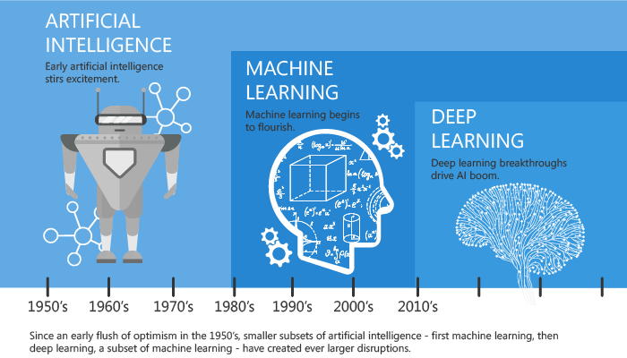
Background/Overview

Slide 3
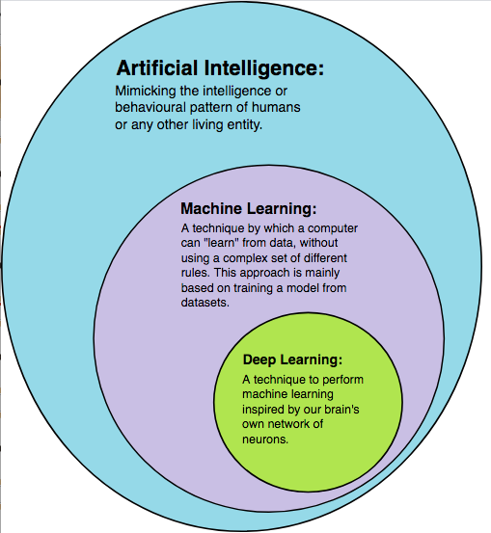

Slide 4
Introduction to Machine Learning
The term “machine learning” was first introduced by Arthur Samuel. He defined it as the “field of study that gives computers the ability to learn without being explicitly programmed”.
It uses statistical methods to give computer the ability to "learn" from data, without being explicitly programmed.
The learning process improves the machine model over time by using training data.
The evolved model is used to make future predictions.

Slide 5
Cont…
If a computer program can improve how it performs certain tasks based on past experiences, then it has learned. This differs from performing the task always the same way because it has been programmed to do so .

Slide 6
Cont…
Statistical Model-A model in a computer is a mathematical function that represents a relationship or mapping between a set of inputs and a set of outputs. e.g
This is an oversimplified example to explain that machine learning refers to a set of techniques for estimating functions (for example, predicting crime incidents) that is based on data sets (pairs of the day’s average temperature and the associated number of crime incidents). These models can be used for predictions of future data.
New data “X” can predict the output “Y”

Slide 7
Machine Learning Algorithms
A machine learning algorithm is a technique through which the system extracts useful patterns from historical data. These patterns can be applied to new data.
The objective is to have the system learn a specific input/output transformation.
The data quality is critical to the accuracy of the machine learning results.

Slide 8
Steps of ML Algorithms
1. Define objective of the problem[what needs to be done]
2. Gather data
3. Prepare / Clean the data[remove missing data, redundant data]
4.Explore the data[E.D.A]-[check for patterns in the data]
5.Build a Model [Split data into training set and testing set and choose a ML to use]
6. Evaluate model [test and check accuracy of model e.g. confusion matrix ,cross validation e.t.c]
7. Make predictions[use model to make predictions]
8. Deploy

Slide 9
Machine Learning Approaches
1. Supervised learning: A machine learning technique that Train by using labeled data, and learn and predict new labels for unseen input data.
Classification is the task of predicting a discrete class label, such as “black, white, or gray” and “tumor or not tumor”.
Regression is the task of predicting a continuous quantity, such as “weight”, “probability”, and “cost”.

Slide 10
Cont…
2. Unsupervised learning: A machine learning technique that Detect patterns and relationships between data without using labeled data.
Clustering algorithms: Discover how to split the data set into a number of groups such that the data points in the same groups are more similar to each other compared to data points in other groups.

Slide 11
Cont…
3. Semi Supervised learning-A machine learning technique that falls between supervised and unsupervised learning. It includes some labeled data with a large amount of unlabeled data.
In semi-supervised learning, you try to get the best out of your unlabeled data
Many real practical problems fall into this category of machine learning where you have little labeled data and the rest of the data is unlabeled. E.g labelling different face types.

Slide 12
Cont…
4. Reinforcement learning-It is a goal-oriented learning that is based on interaction with the environment. As the system performs certain actions, it finds out more about the world .It uses trial and error (a rewarding/punishment approach).
The algorithm discovers an association between the goal and the sequence of events that leads to a successful outcome.
Example reinforcement learning applications:
Robotics: A robot that must find its way.
Self-driving cars.

Slide 13
Cont…
Understanding your problem and the different types of ML algorithms helps in selecting the best algorithm.
Some Common machine learning algorithms include:
Naïve Bayes classification (supervised classification – probabilistic)
Linear regression (supervised regression)
Logistic regression (supervised classification)
Support vector machine (SVM) (supervised linear or non-linear classification)
Decision tree (supervised non-linear classification)
K-means clustering (unsupervised learning)

Slide 14
Naïve Bayes classification
Naïve Bayes classifiers is a powerful and simple supervised machine learning algorithm. It assumes that the value of a particular feature is independent of the value of any other feature, given the class variable.
For example, a fruit may be considered to be an apple if it is red, round, and about 10 cm in diameter.
Features: Color, roundness, and diameter.
A Naïve Bayes classifier considers each of these features to contribute independently to the probability that this fruit is an apple, regardless of any possible correlations between the color, roundness, and diameter features.

Slide 15
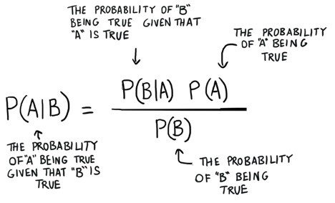
Equation for Naïve Bayes algorithm

Slide 16
Linear regression
Regression algorithms help analysts to model relationships between input variables X and the output label Y for the training data points. This algorithm targets supervised regression problems, that is, the target variable is a continuous value.
In simple linear regression, we establish a relationship between the target variable and input variables by fitting a line that is known as the regression line. E.g
Analyze the marketing effectiveness, pricing, and promotions on the sales of a product.
Forecast sales by analyzing the monthly company’s sales for the past few years.
Analyze the amount of hours spent in the gym and the Weight loss achieved

Slide 17
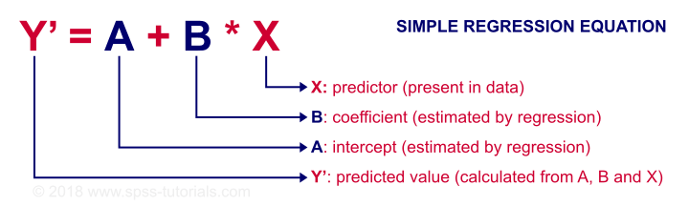
Linear regression equation

Slide 18
Logistic regression
Logistic regression is a supervised classification algorithm. It is different from linear regression where the dependent or output variable is a category or class. The target is a discrete category or a class (not a continuous variable as in linear regression), for example, Class1 = cancer, Class2 = No Cancer.
Logistic regression is named for the function that is used at the core of the algorithm, which is the logistic function (sigmoid function). It is an S-shaped curve for data segregation across multiple classes that can take any real value 0 - 1.

Slide 19
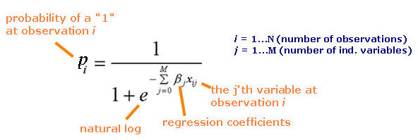
Logistic Regression Equation

Slide 20
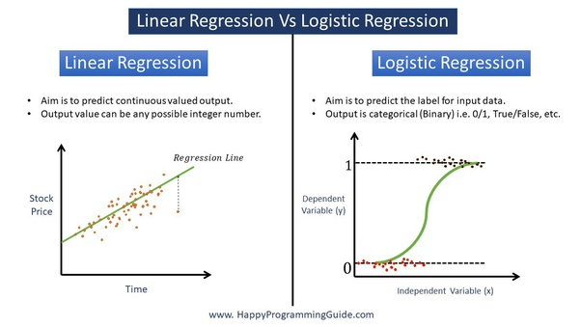
Comparison between Linear and Logistic regression

Slide 21
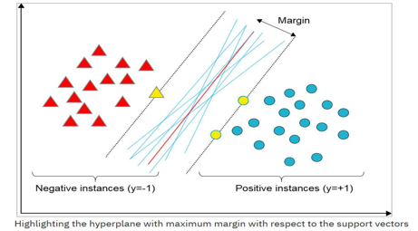
Support Vector Machine (SVM)
SVM is a supervised learning model that can be a linear or non-linear classifier. SVM is also called a “large Margin Classifier” because the algorithm seeks the hyperplane with the largest margin, that is, the largest distance to the nearest sample points
Although many lines (in light blue) do separate all instances correctly, there is only one optimal hyperplane (red line) that maximizes the distance to the closest points (in yellow).

Slide 22
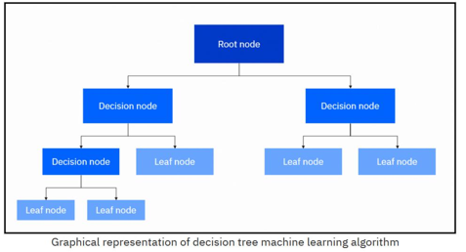
Decision Tree
A decision tree is a popular supervised learning algorithm that can be used for classification and regression problems. Decision trees are a popular prediction method. Decision trees can explain why a specific prediction was made by traversing the tree.
A decision tree includes three main entities: root node, decision nodes, and leaves. The figure shows the graphical representation of these entities.
A decision tree builds the classification or regression model in the form of a tree structure.

Slide 23
Decision tree cont..
The algorithm works by recursively splitting the data based on the value of a feature. After each split, the portion of the data becomes more homogeneous.
Now, the algorithm needs to decide:
Which feature to choose as the root node.
What conditions to use for splitting.
When to stop splitting

Slide 24
Decision tree cont..
The Iterative Dichotomiser3 (ID3) is a decision tree algorithm that works by using entropy and information gain to construct a decision tree.
Entropy is the measure of the amount of uncertainty and randomness in a set of data for the classification task. Entropy is maximized when all points have equal probabilities. Entropy zero means that there is no randomness for this attribute.
Information gain is a metric that is used for ranking the attributes or features to split at given node in the tree. It defines how much information a feature provides about a class. The feature with the highest information gain is used for the first split.

Slide 25
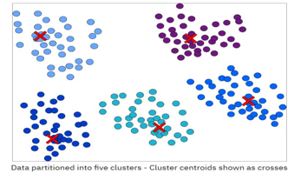
K-means Clustering
K-means clustering is an unsupervised machine learning technique. It groups a set of objects in such a way that objects in the same group (called a cluster) are more similar to each other than those in other groups (other clusters).
The main goal of the algorithm is to group the data observations into k clusters, where each observation belongs to the cluster with the nearest mean

Slide 26
Artificial Neural Networks
Human brain is comprised of cells called Neurons.
Neurons are the building blocks of Neural Networks
Neurons are highly connected and communicate chemical signals through the synapses (a junction between two nerve cells) between the axons(Connect neurons to other cells) and dendrites(Accept input/stimuli from the external environment). These inputs create electronic impulses(spikes) which are passed quickly across the neural network. The effect of this is an action/response

Slide 27
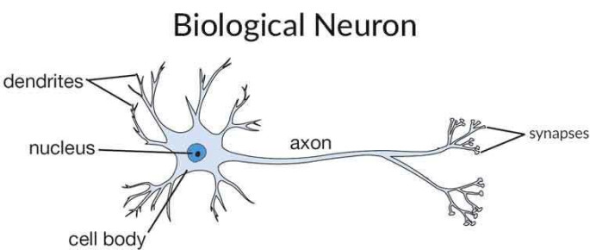
Structure of Biological Neuron
The human brain is estimated to have 100 billion neurons, with each neuron connected to up to 10,000 other neurons.

Slide 28
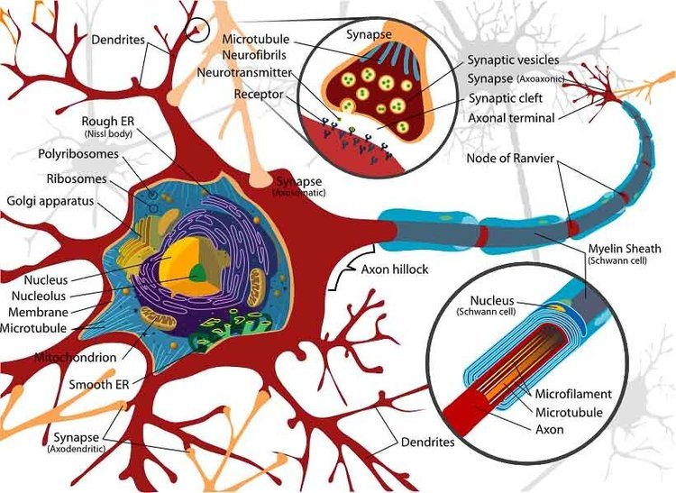

Slide 29
Artificial Neural Networks
ANN are a hardware and software implementation which tries to simulate information processing capabilities of biological NN.
They are collections of interconnected “neurons” (called nodes) that work together to transform input data to output data.
Each node applies a mathematical transformation to the data it receives; it then passes its result to the other nodes in its path.
Examples for applications:
Object detection, tracking, and image analysis (Convolutional Neural Network (CNN))
Natural language processing /machine Translation (recurrent neural network (RNN ))
Autonomous cars and robots (more complex neural networks)

Slide 30
Cont….
ANN communicate signals (input numbers) through weights and activation functions that activate neurons. Using a training algorithm, these networks adjust those weights to solve a problem.
Each node applies a mathematical transformation to the data it receives; it then passes its result to the other nodes in its path. Each connection between nodes represents a different parameter to the model.
A perceptron is a single neuron model that was an originator for neural networks.

Slide 31
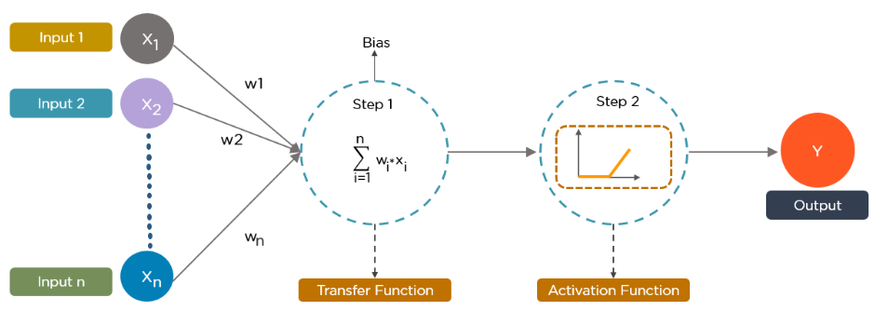
Structure of Neuron/Perceptron[mcculloch pitt model]

Slide 32
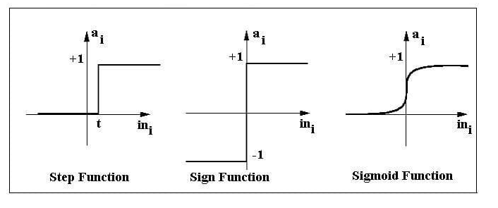
Cont…
Activation function/Transfer function- Activation function decides, whether a neuron should be activated or not by calculating weighted sum and further adding bias with it. In summary, it is used to determine the output of a ANN. Common ones are step, sigmoid or linear.

Slide 33
Cont…
A Perceptron can be viewed as an algorithm for supervised learning of binary classifiers. This algorithm enables neurons to learn and processes elements in the training set one at a time.
There are two types of Perceptrons: Single layer and Multilayer.
Single layer Perceptrons can learn only linearly separable patterns.
Multilayer Perceptrons or feedforward neural networks with two or more layers have the greater processing power.
Perceptron Learning Rule states that the algorithm would automatically learn the optimal weight coefficients. The input features are then multiplied with these weights to determine if a neuron fires or not.

Slide 34
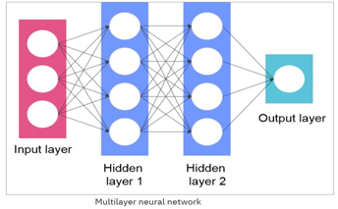

Single Layer Vs Multilayer NN

Slide 35
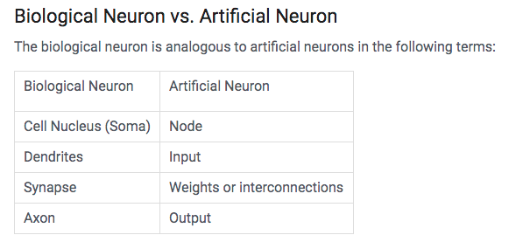
Comparison of a Biological Network and Artificial Neuron

Slide 36
General structure of a ANN
A neural network is composed of three or more layers: an input layer, one or many hidden layers, and an output layer.
Data is imported through the input layer. Then, the data is modified in the hidden and output layers based on the weights that are applied to their nodes. The typical neural network can consist of thousands or even millions of simple processing nodes that are densely interconnected.
Each link is associated with a weight .ANN are capable of learning what takes place by altering these weights.

Slide 37


Slide 38
Types of ANN
2 main types exist as follows:
a) Feed forward ANN[multilayer perceptron]
b) Feed Back ANN[recurrent ANNs]

Slide 39
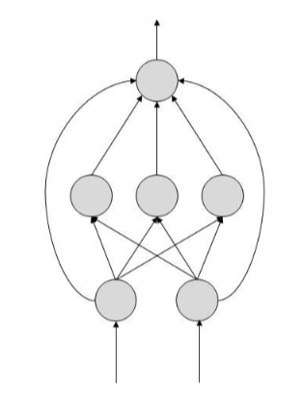
Feed forward ANNs
Information flow is unidirectional
A unit send information to the next unit from which it does not receive any information.
It has no feedback loops
It has fixed input and output
Used in pattern recognition
and classification

Slide 40
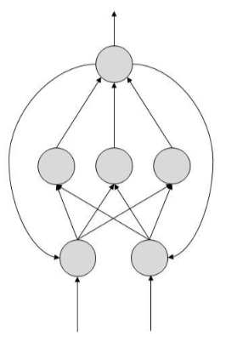
Feed back ANNs
A unit sends information to the next unit from which it does can also receive any information.
Have feedback loops

Slide 41
Back propagation[Technique for training ANNs]
Back propagation is an algorithm for training neural networks that have many layers. If you give an example you want the network to solve, it changes the network weights until it reaches desired output . It works in two phases:
First phase: The propagation of inputs through a neural network to the final layer (called feed-forward).
Second phase: The algorithm computes an error. An error value is then calculated by using the wanted output and the actual output for each output neuron in the network. The error value is propagated backward through the weights of the network (adjusting the weights) beginning with the output neurons through the hidden layer and to the input layer (as a function of the contribution of the error).

Slide 42
Learning rules used for ANNs
Error correction/ trial and error rules
Boltzmann rule
Hebbian rule
Competitive learning rule

Slide 43
Applications of ANN
Automotive guidance[ALVINN]
Speech recognision
Time series prediction
Transportation[vehicle scheduling]
Medicine[cancer diagnosis]
Image recognition[CNN as used for processing pixel data]

Slide 44
Advantages of ANNs
Can adopt to unknown conditions/ Uncertainty
Can be use to model complex functions[e.g human mind functioning]

Slide 45
Disadvantages of ANNs
They become very complex for large problems
They are not good for preciseness/not exact

Slide 46
Deep Learning
Deep learning is a machine learning technique that uses neural networks to learn.
It is Similar to a traditional neural network, but it has many more hidden layers.
The more complex the problem, the more hidden layers there are in the model.
[Facebook is working on ‘deep learning’ neural networks to learn even more about your personal life. nobody has access to more raw information than Facebook.]

Slide 47
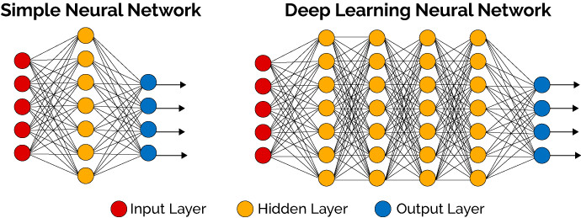
Cont..

Slide 48
Cont.…
Deep learning has emerged now because of the following reasons:
The continuous increase in big data requires data processing scaling to analyze and use this data correctly.
Improvement in processing power and the usage of GPUs to train neural networks.
Advancement in algorithms like the rectified linear unit (ReLU) instead of the Sigmoid algorithm helps make gradient descent converge faster.

Slide 49
Applications of Deep learning
Speech recognition. All major commercial speech recognition systems (like Microsoft Cortana, Alexa, Google Assistant, Apple Siri) are based on deep learning.
Pattern recognition. Pattern recognition systems are already able to give more accurate results than the human eye in medical diagnosis.
Natural language processing. Neural networks have been used to implement language models since the early 2000s. The invention of LSTM helped improve machine translation and language modeling.
Discovery of new drugs. For example, the AtomNet neural network has been used to predict new biomolecules that can potentially cure diseases such as Ebola and multiple sclerosis.
Recommender systems. Today, deep learning is being used to study user preferences across many domains. Netflix is one of the brightest examples in this field.

Slide 50
Applications of Deep learning
Multilayer perceptron (MLP): Classification and regression, for example, a house price prediction.
Convolutional neural network (CNN): For image processing like facial recognition.
Recurrent neural network (RNN): For one-dimensional sequence input data. Like audio and languages.
Hybrid neural network: Covering more complex neural networks, for example, autonomous cars.

Slide 51
How To Evaluate a Machine learning Model
After you have successfully trained your model, you need a methodology to follow to evaluate your machine learning model performance .
The objective of a good machine learning model is to generalize for any future data points.
A classic mistake is to use the same sample data that is used in training to test a model, which produces a false perfect score. This is called “overfitting” (also referred as “high variance”). The problem with overfitting is that your model fails at predicting future unseen data.

Slide 52
How To Evaluate a Machine learning Model
Another case that can cause overfitting is where you have unbalanced data. For example, assume that you are working on a data set for churn analysis. The customers who churned are actually 2% of your data set. Using this data set “as is” causes overfitting
Overfitting can also occur if you are using too many features. Relatively, if the number of features is the same as or greater than the number of training samples, that can cause overfitting.

Slide 53
Cont..
Solutions to overfitting problem
One of the solutions to overcome overfitting is to increase the number of data set samples that is used for training compared to features.
Another solution is to manually decrease the number of features, but that might result in removing useful information.
Another solution is to perform model selection by using cross-validation.

Slide 54
Cont.…
Underfitting (also referred to as “high bias”) occurs when a machine learning model cannot fit the training data or generalize to new data.
A possible reason might be that the model is using a simple estimator. For example, you might be using a linear estimator.
Another reason might be that you are not using enough features, so your estimator fails to capture the structure of the data

Slide 55
Solutions to underfitting problem
Using the right quadratic or higher degree polynomial estimator to develop your model like in “Right fit” graph instead of a simple linear estimator equation
A possible solution would be to add more features and try a different estimator.

Slide 56
Cont.…
Cross-validation (CV) is a process to evaluate a model by dividing the data set once or several times in training and testing.
Hold-out method: Randomly splits the data set into a training set and test set.
K-fold cross validation: Splits data into K subsamples where each subsample gets a chance to be the validation set, and K-1 is the training set.
Leave one out cross validation (LOO-CV): Similar to K-fold except that one subsample that contains one data point is held out, and the rest of data is used for training

